Slide 1
Power System Fault Detection and Classification
CAPSTONE PROJECT
Presented By:
Athul Raj S R – Trinity Institute of Professional Studies – Department Of Computer Applications

Slide 2
OUTLINE
Problem Statement
Proposed System/Solution
System Development Approach (Technology Used)
Algorithm & Deployment
Result (Output Image)
Conclusion
Future Scope
References

Slide 3
Problem Statement
Power systems often face faults like line-to-ground, line-to-line, and three-phase faults, which can affect grid stability. Traditional fault detection methods are slow and manual.
This project aims to build a machine learning model that uses electrical data (voltage, current, phasors) to automatically detect and classify these faults accurately and quickly.

Slide 4
Proposed Solution
Develop a machine learning model that classifies power system faults using the dataset provided .The model will process electrical measurements to identify the type of fault rapidly and accurately . This classification will help automate fault detection and assist in quicker recovery actions , ensuring system reliability.
Key components:
Data Collection: Use the Kaggle dataset on power system faults.
Preprocessing: Clean and normalize the dataset.
Model Training: Train a classification model (e.g., Decision Tree, Random Forest, or SVM).
Evaluation: Validate the model using accuracy, precision, recall, and F1-score.

Slide 5
System Approach
The "System Approach" section outlines the overall strategy and methodology for developing and implementing the power system fault detection and classification. Here's a suggested structure for this section:
System Requirements:
IBM Cloud (mandatory).
IBM Watson Studio for model development and deployment.
IBM Cloud Object Storage for dataset handling

Slide 6
Algorithm & Deployment
Algorithm Selection:
Random Forest Classifier (or SVM based on performance)
Data Input:
Voltage, current, and phasor measurements from the dataset
Training Process:
Supervised learning using labeled fault types
Prediction Process : Model deployed on IBM Watson Studio with API endpoint for real-time predictions

Slide 7
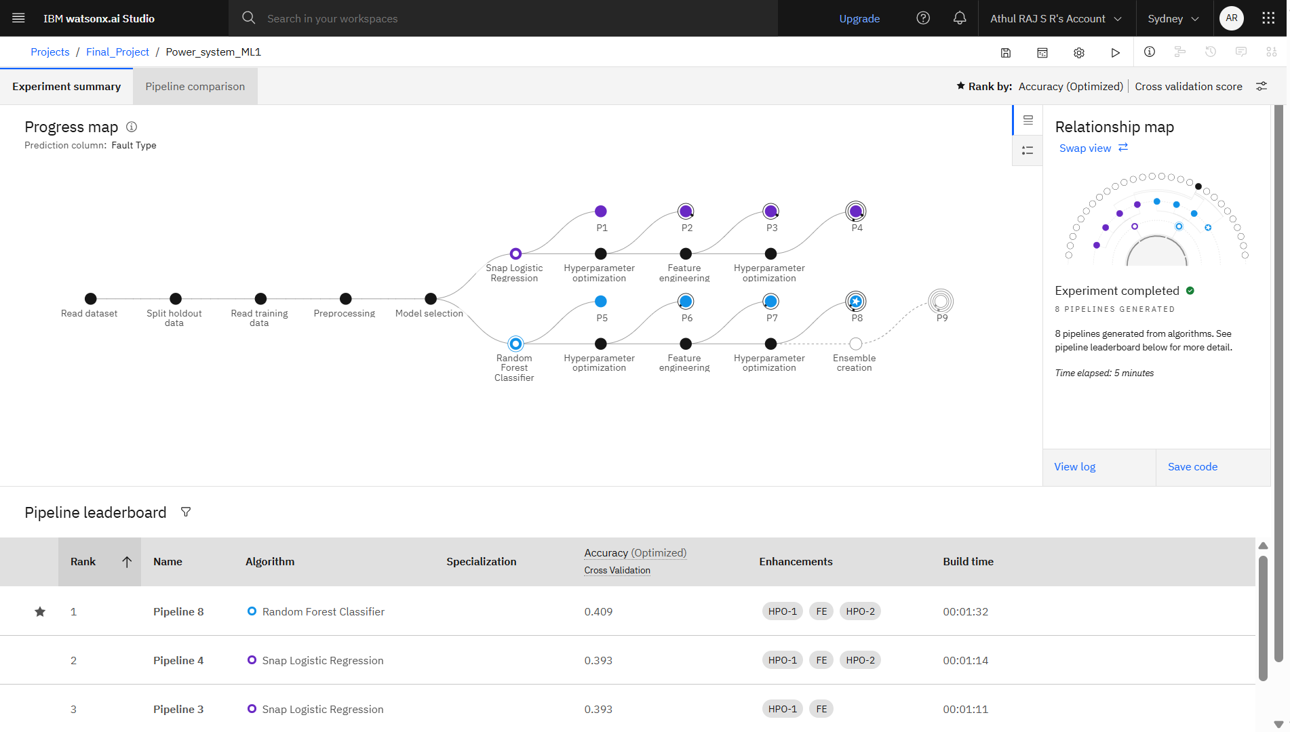
Result

Slide 8
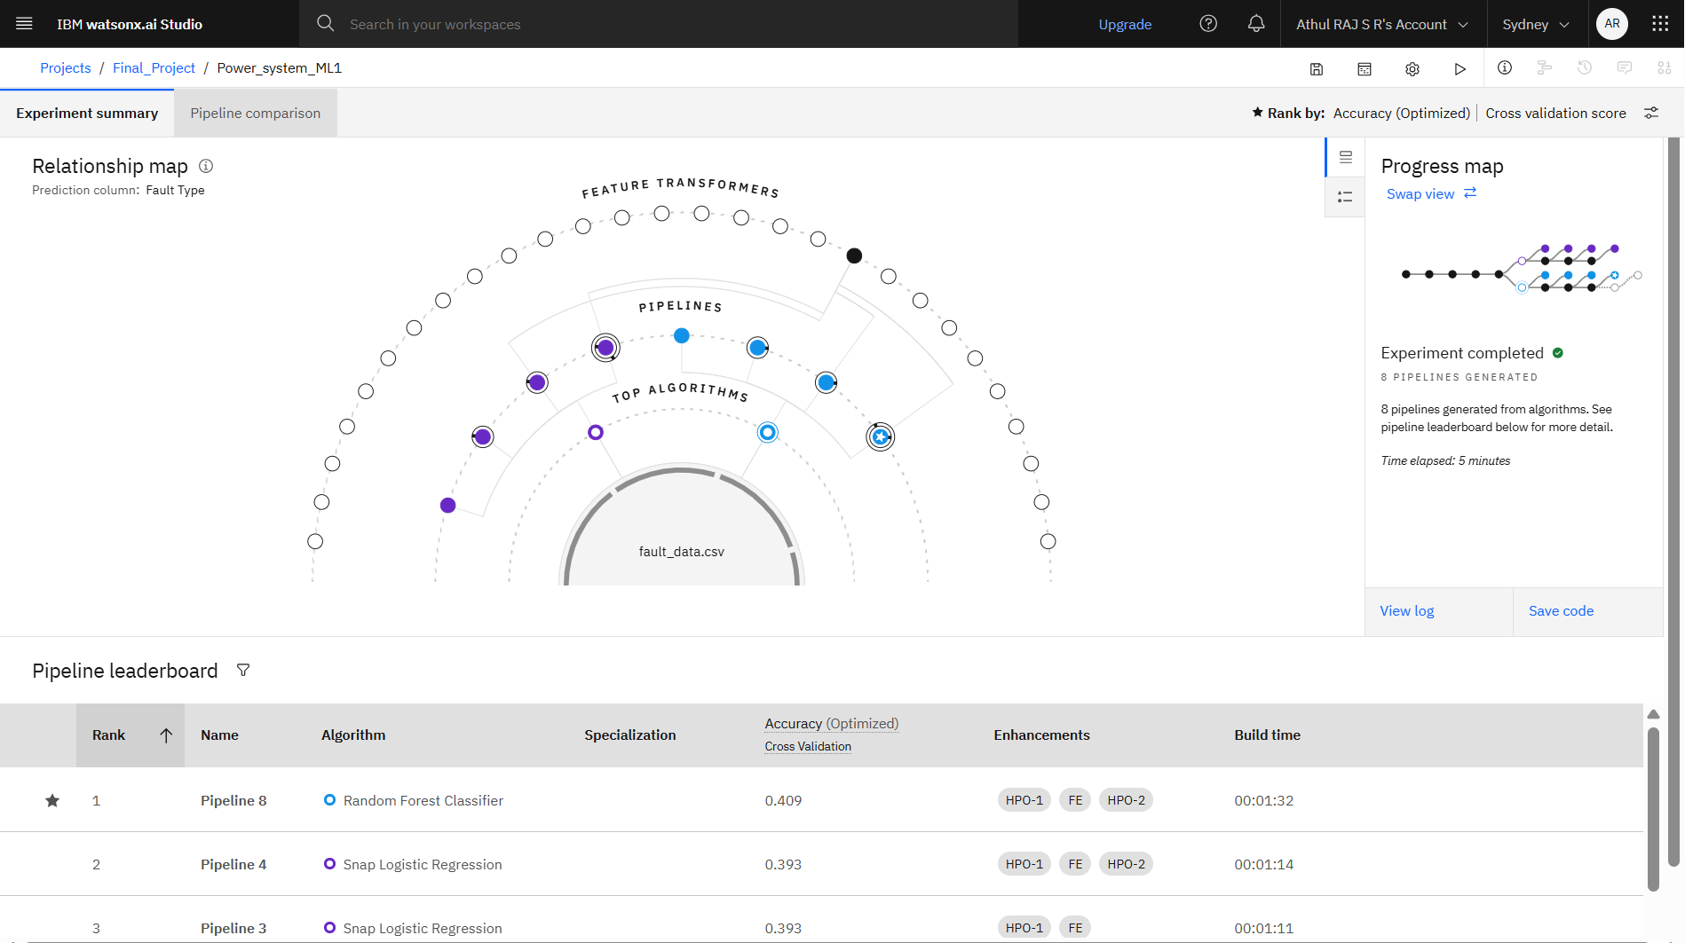
Result

Slide 9
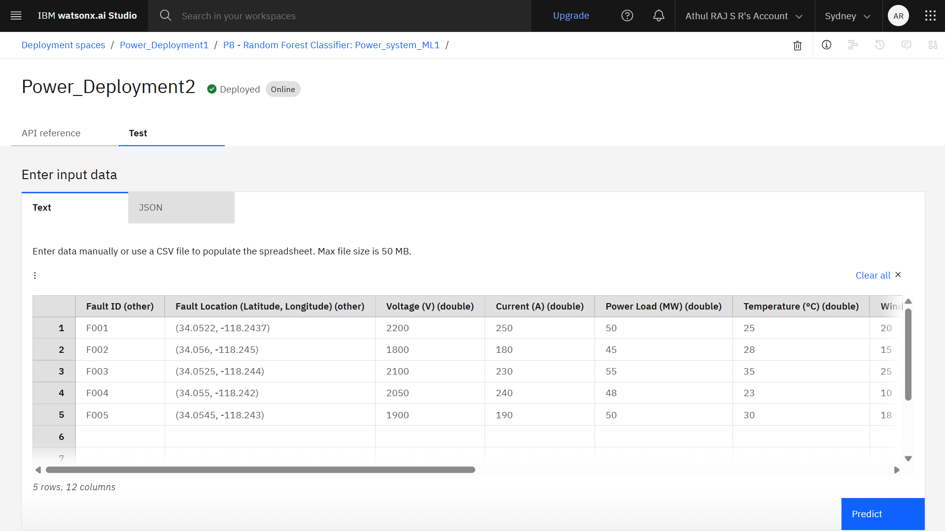
Result

Slide 10
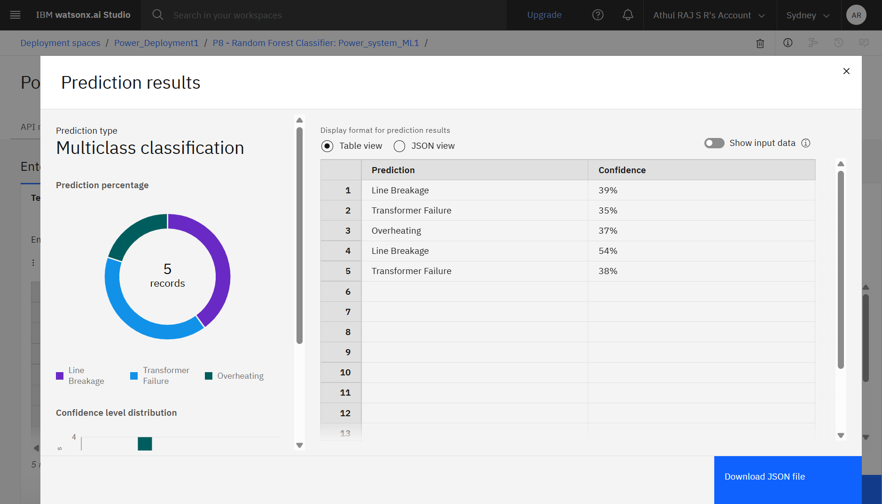
Result

Slide 11
Conclusion
The machine learning-based fault classification system successfully automates fault detection in power systems
It enhances response time and reliability of the grid, with high accuracy using Random Forest.
The system is cloud-deployed and can be scaled or integrated into existing smart grid frameworks.
GITHUB Repo Link: https://github.com/AthulRaj655/IBM-Project-On-AI-Cloud.git

Slide 12
Future scope
Integrating real-time sensor data for immediate detection.
Expanding the system for more fault types and large-scale deployment.
Exploring additional models and feature engineering techniques.
Adopting edge computing for low-latency predictions in smart grids.

Slide 13
References
1. Kaggle Dataset – Power System Faults
https://www.kaggle.com/datasets/ziya07/power-system-faults-dataset
2. IBM Watson Studio – AutoAI Tool
https://www.ibm.com/cloud/watson-studio
3. IBM Cloud Documentation
https://cloud.ibm.com/docs

Slide 14
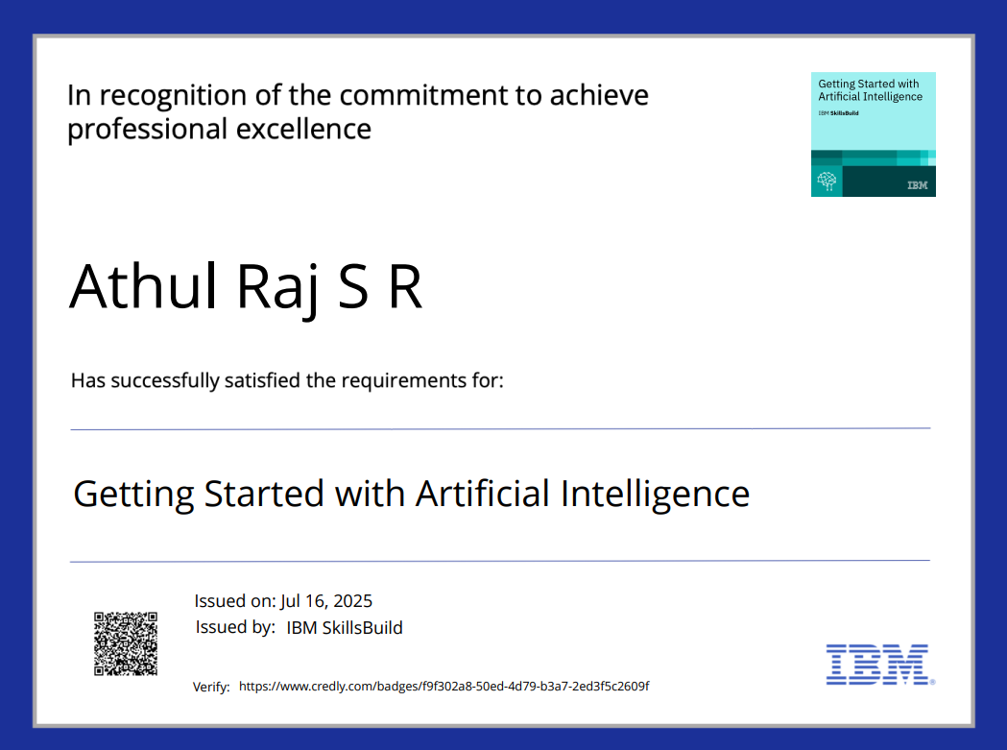
IBM Certifications

Slide 15
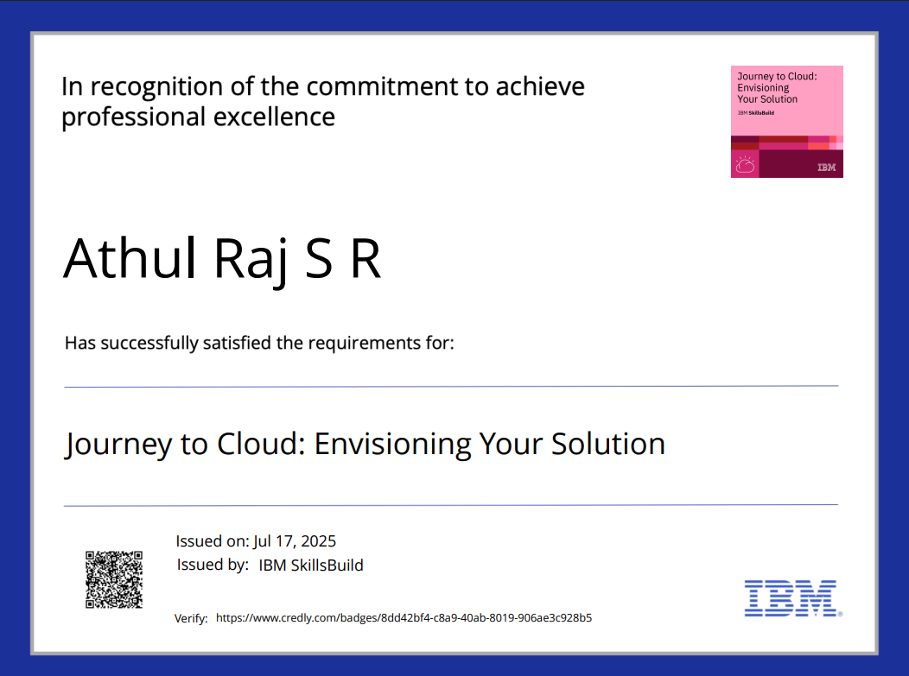
IBM Certifications

Slide 16
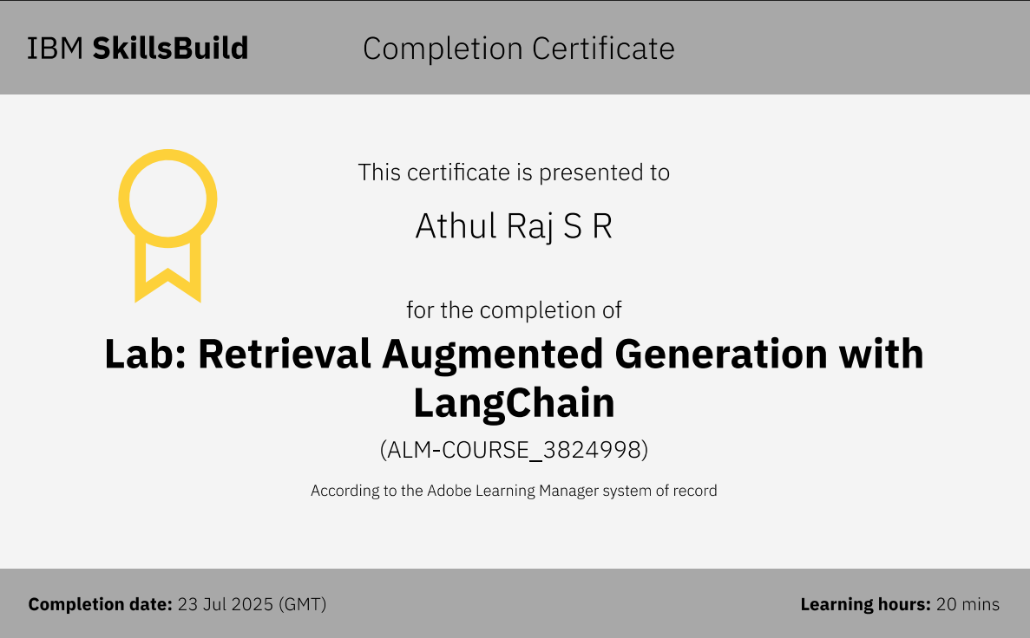
IBM Certifications

Slide 17
THANK YOU

